Slide 1

Qantas Airlines SQL Project
Michael Le

Slide 2

Requirements
Files and Sources: Main-Stuff/DA Bootcamp 2026 Emergi Mentors/Week 2 SQL Mastery/Module 3 Intermediate SQL for Analytics Professionals/Qantas_Frequent_Flyer_Analysis at main · Mikele02171/Main-Stuff
Microsoft SQL Server Express (2022 or (2025 preferred))

Slide 3

Content
Create Database for Qantas
DDL: Create members, flights
DML: Insert values into members, flights
DQL: Validation
DQL: Member flight Summary using Subquery
DQL: Member flight Summary using CTE
DQL: Combine Status credits, eligible flights and last flight date per member
DQL: Calculate total SC per member, tier earned, mismatches and upgrade opportunities
DQL: Tier close Campaign
DQL: Member Flight Summary with 3+ flights
DQL: Premium vs. Economy
DQL: CTE Chain – Route Popularity
DQL: Tier Upgrade Candidates
DQL: Inactive High-Value Members

Slide 4

Create Database for Qantas
USE master;
GO
-- Drop database if exists (fresh start)
IF EXISTS (SELECT name FROM sys.databases WHERE name = 'Qandas_FrequentFlyer')
BEGIN
PRINT 'Dropping existing Qandas_FrequentFlyer database...';
ALTER DATABASE Qandas_FrequentFlyer SET SINGLE_USER WITH ROLLBACK IMMEDIATE;
DROP DATABASE Qandas_FrequentFlyer;
PRINT '✅ Existing database dropped successfully';
END
GO
-- Create fresh database
CREATE DATABASE Qandas_FrequentFlyer;
GO
USE Qandas_FrequentFlyer;
GO

Slide 5
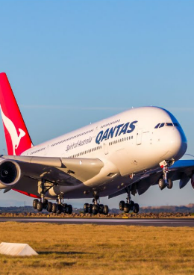
DDL: Create members and flights table
-- Frequent flyer members table
CREATE TABLE members (
member_id INT PRIMARY KEY,
member_name NVARCHAR(100),
email NVARCHAR(100),
current_tier NVARCHAR(20),
join_date DATE,
home_city NVARCHAR(50)
);
-- Flight history table
CREATE TABLE flights (
flight_id INT PRIMARY KEY,
member_id INT FOREIGN KEY REFERENCES members(member_id),
flight_date DATE,
route NVARCHAR(100),
flight_class NVARCHAR(20),
status_credits INT,
points_earned INT,
eligible_flight BIT -- 1 = counts toward tier qualification, 0 = doesn't
);

Slide 6
DML: Insert values into members table
INSERT INTO members VALUES
-- Bronze members (potential tier-close candidates)
(1001, 'Sarah Mitchell', 'sarah.mitchell@email.com', 'Bronze', '2022-03-15', 'Sydney'),
(1002, 'James Chen', 'james.chen@email.com', 'Bronze', '2023-01-20', 'Melbourne'),
(1003, 'Emma Thompson', 'emma.thompson@email.com', 'Bronze', '2021-06-10', 'Brisbane'),
(1004, 'Liam O''Connor', 'liam.oconnor@email.com', 'Bronze', '2022-08-25', 'Perth'),
(1005, 'Olivia Patel', 'olivia.patel@email.com', 'Bronze', '2023-02-14', 'Adelaide'),
-- Silver members (close to Gold - tier-close candidates)
(1006, 'William Zhang', 'william.zhang@email.com', 'Silver', '2021-04-05', 'Sydney'),
(1007, 'Ava Nguyen', 'ava.nguyen@email.com', 'Silver', '2022-07-18', 'Melbourne'),
(1008, 'Noah Williams', 'noah.williams@email.com', 'Silver', '2020-11-30', 'Brisbane'),
(1009, 'Isabella Brown', 'isabella.brown@email.com', 'Silver', '2022-05-22', 'Sydney'),
(1010, 'Mason Taylor', 'mason.taylor@email.com', 'Silver', '2021-09-14', 'Melbourne'),
-- Gold members (close to Platinum - tier-close candidates)
(1011, 'Sophia Anderson', 'sophia.anderson@email.com', 'Gold', '2020-02-10', 'Sydney'),
(1012, 'Lucas Martin', 'lucas.martin@email.com', 'Gold', '2019-12-05', 'Brisbane'),
(1013, 'Charlotte Garcia', 'charlotte.garcia@email.com', 'Gold', '2021-08-17', 'Perth'),
-- Platinum members (already at top tier)
(1014, 'Ethan Rodriguez', 'ethan.rodriguez@email.com', 'Platinum', '2018-05-20', 'Sydney'),
(1015, 'Amelia Lee', 'amelia.lee@email.com', 'Platinum', '2019-03-12', 'Melbourne'),
-- Additional mixed tier members
(1016, 'Benjamin Kim', 'benjamin.kim@email.com', 'Bronze', '2023-04-08', 'Sydney'),
(1017, 'Harper Singh', 'harper.singh@email.com', 'Silver', '2022-10-15', 'Melbourne'),
(1018, 'Evelyn Tran', 'evelyn.tran@email.com', 'Gold', '2020-07-25', 'Brisbane'),
(1019, 'Alexander Liu', 'alexander.liu@email.com', 'Bronze', '2023-06-30', 'Perth'),
(1020, 'Mia Johnson', 'mia.johnson@email.com', 'Silver', '2021-11-20', 'Adelaide’);
-- Insert flight data with TIER-CLOSE scenarios planted
DECLARE @today DATE = '2024-12-01';

Slide 7

DML: Insert values into flights table Part 1
-- Member 1001 (Sarah) - 280 SC, 3 eligible flights (CLOSE TO SILVER - needs 20 SC, 1 flight)
INSERT INTO flights VALUES
(2001, 1001, DATEADD(DAY, -45, @today), 'Sydney-Melbourne', 'Economy', 80, 1200, 1),
(2002, 1001, DATEADD(DAY, -60, @today), 'Melbourne-Brisbane', 'Economy', 100, 1500, 1),
(2003, 1001, DATEADD(DAY, -90, @today), 'Brisbane-Sydney', 'Economy', 100, 1500, 1);
-- Member 1002 (James) - 150 SC, 2 eligible flights (NOT tier-close, too few flights)
INSERT INTO flights VALUES
(2004, 1002, DATEADD(DAY, -30, @today), 'Melbourne-Sydney', 'Economy', 80, 1200, 1),
(2005, 1002, DATEADD(DAY, -120, @today), 'Sydney-Perth', 'Economy', 70, 1000, 1);
-- Member 1003 (Emma) - 260 SC, 4 eligible flights (CLOSE TO SILVER but already has 4 flights)
INSERT INTO flights VALUES
(2006, 1003, DATEADD(DAY, -20, @today), 'Brisbane-Sydney', 'Economy', 80, 1200, 1),
(2007, 1003, DATEADD(DAY, -40, @today), 'Sydney-Melbourne', 'Economy', 60, 900, 1),
(2008, 1003, DATEADD(DAY, -70, @today), 'Melbourne-Perth', 'Economy', 60, 900, 1),
(2009, 1003, DATEADD(DAY, -100, @today), 'Perth-Brisbane', 'Economy', 60, 900, 1);

Slide 8

DML: Insert values into flights table Part 2
-- Member 1004 (Liam) - 295 SC, 3 eligible flights (CLOSE TO SILVER - HIGH PRIORITY - needs only 5 SC!)
INSERT INTO flights VALUES
(2010, 1004, DATEADD(DAY, -15, @today), 'Perth-Sydney', 'Business', 120, 3000, 1),
(2011, 1004, DATEADD(DAY, -35, @today), 'Sydney-Melbourne', 'Economy', 85, 1300, 1),
(2012, 1004, DATEADD(DAY, -55, @today), 'Melbourne-Perth', 'Economy', 90, 1400, 1);
-- Member 1006 (William) - 665 SC, 3 eligible flights (CLOSE TO GOLD - needs 35 SC, 1 flight)
INSERT INTO flights VALUES
(2013, 1006, DATEADD(DAY, -25, @today), 'Sydney-Singapore', 'Business', 180, 4500, 1),
(2014, 1006, DATEADD(DAY, -50, @today), 'Singapore-London', 'Business', 250, 6000, 1),
(2015, 1006, DATEADD(DAY, -80, @today), 'London-Sydney', 'Business', 235, 5800, 1);
-- Member 1007 (Ava) - 680 SC, 3 eligible flights (CLOSE TO GOLD - needs 20 SC, 1 flight)
INSERT INTO flights VALUES
(2016, 1007, DATEADD(DAY, -10, @today), 'Melbourne-Tokyo', 'Business', 200, 5000, 1),
(2017, 1007, DATEADD(DAY, -40, @today), 'Tokyo-Sydney', 'Business', 240, 6000, 1),
(2018, 1007, DATEADD(DAY, -75, @today), 'Sydney-Melbourne', 'Business', 240, 6000, 1);
-- Member 1011 (Sophia) - 1375 SC, 3 eligible flights (CLOSE TO PLATINUM - needs 25 SC, 1 flight)
INSERT INTO flights VALUES
(2019, 1011, DATEADD(DAY, -12, @today), 'Sydney-Los Angeles', 'First', 450, 10000, 1),
(2020, 1011, DATEADD(DAY, -30, @today), 'Los Angeles-New York', 'First', 480, 11000, 1),
(2021, 1011, DATEADD(DAY, -65, @today), 'New York-Sydney', 'First', 445, 10500, 1);

Slide 9
DML: Insert values into flights table Part 3
-- Member 1012 (Lucas) - 1390 SC, 4 eligible flights (CLOSE TO PLATINUM but already has 4 flights)
INSERT INTO flights VALUES
(2022, 1012, DATEADD(DAY, -18, @today), 'Brisbane-Hong Kong', 'Business', 350, 8000, 1),
(2023, 1012, DATEADD(DAY, -45, @today), 'Hong Kong-London', 'Business', 380, 9000, 1),
(2024, 1012, DATEADD(DAY, -72, @today), 'London-Dubai', 'Business', 330, 7500, 1),
(2025, 1012, DATEADD(DAY, -95, @today), 'Dubai-Brisbane', 'Business', 330, 7500, 1);
-- Member 1014 (Ethan) - 1850 SC, 5 eligible flights (Already Platinum, well over requirement)
INSERT INTO flights VALUES
(2026, 1014, DATEADD(DAY, -8, @today), 'Sydney-San Francisco', 'First', 460, 11000, 1),
(2027, 1014, DATEADD(DAY, -22, @today), 'San Francisco-Tokyo', 'First', 420, 10000, 1),
(2028, 1014, DATEADD(DAY, -50, @today), 'Tokyo-Sydney', 'First', 450, 10500, 1),
(2029, 1014, DATEADD(DAY, -85, @today), 'Sydney-London', 'First', 260, 6000, 1),
(2030, 1014, DATEADD(DAY, -120, @today), 'London-Sydney', 'First', 260, 6000, 1);

Slide 10
DML: Insert values into flights table Part 4
-- Add some inactive members and regular flyers for practice exercises
INSERT INTO flights VALUES
-- Member 1008 (Noah) - Regular Silver, not tier-close
(2031, 1008, DATEADD(DAY, -35, @today), 'Brisbane-Sydney', 'Economy', 85, 1300, 1),
(2032, 1008, DATEADD(DAY, -60, @today), 'Sydney-Melbourne', 'Economy', 90, 1400, 1),
(2033, 1008, DATEADD(DAY, -90, @today), 'Melbourne-Brisbane', 'Economy', 85, 1300, 1),
(2034, 1008, DATEADD(DAY, -125, @today), 'Brisbane-Perth', 'Economy', 95, 1450, 1),
-- Member 1009 (Isabella) - Inactive for 8 months (for practice exercise)
(2035, 1009, DATEADD(DAY, -240, @today), 'Sydney-Melbourne', 'Business', 120, 3000, 1),
(2036, 1009, DATEADD(DAY, -270, @today), 'Melbourne-Brisbane', 'Business', 110, 2800, 1),
-- Member 1013 (Charlotte) - Gold with good activity
(2037, 1013, DATEADD(DAY, -20, @today), 'Perth-Sydney', 'Business', 180, 4500, 1),
(2038, 1013, DATEADD(DAY, -48, @today), 'Sydney-Singapore', 'Business', 200, 5000, 1),
(2039, 1013, DATEADD(DAY, -78, @today), 'Singapore-Perth', 'Business', 195, 4800, 1),
(2040, 1013, DATEADD(DAY, -110, @today), 'Perth-Melbourne', 'Business', 190, 4700, 1),
(2041, 1013, DATEADD(DAY, -145, @today), 'Melbourne-Perth', 'Business', 185, 4600, 1);

Slide 11

DQL: Validation
SELECT 'Members' AS TableName, COUNT(*) AS [RowCount] FROM members
UNION ALL
SELECT 'Flights' AS TableName, COUNT(*) AS [RowCount] FROM flights;
GO

Slide 12
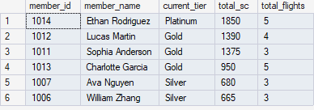
DQL: Member flight Summary using Subquery
WITH member_stats AS (
SELECT
m.member_id,
m.member_name,
m.current_tier,
SUM(f.status_credits) AS total_sc,
COUNT(*) AS total_flights
FROM members m
LEFT JOIN flights f ON m.member_id = f.member_id
GROUP BY m.member_id, m.member_name, m.current_tier
)
SELECT
member_id,
member_name,
current_tier,
total_sc,
total_flights
FROM member_stats
WHERE total_sc > 500
ORDER BY total_sc DESC;

Slide 13
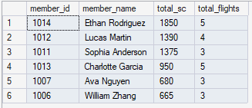
DQL: Member flight Summary using CTE
WITH member_stats AS (
SELECT
member_id,
SUM(status_credits) AS total_sc,
COUNT(*) AS total_flights
FROM flights
GROUP BY member_id
)
SELECT
m.member_id,
m.member_name,
ms.total_sc,
ms.total_flights
FROM members m
LEFT JOIN member_stats ms ON m.member_id = ms.member_id
WHERE ms.total_sc > 500
ORDER BY ms.total_sc DESC;

Slide 14
DQL: Combine Status credits, eligible flights and last flight date per member Part 1
WITH
-- Step 1: Total status credits per member
status_credits AS (
SELECT
member_id,
SUM(status_credits) AS total_sc
FROM flights
GROUP BY member_id
),
-- Step 2: Count eligible flights per member
eligible_flights AS (
SELECT
member_id,
COUNT(*) AS eligible_count
FROM flights
WHERE eligible_flight = 1
GROUP BY member_id
),
-- Step 3: Last flight date per member
last_flight AS (
SELECT
member_id,
MAX(flight_date) AS last_flight_date
FROM flights
GROUP BY member_id
)

Slide 15
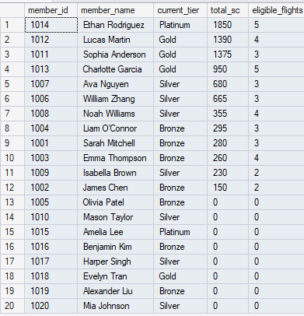
DQL: Combine Status credits, eligible flights and last flight date per member Part 2
-- Step 4: Combine everything
SELECT
m.member_id,
m.member_name,
m.current_tier,
ISNULL(sc.total_sc, 0) AS total_sc,
ISNULL(ef.eligible_count, 0) AS eligible_flights,
lf.last_flight_date,
DATEDIFF(DAY, lf.last_flight_date, GETDATE()) AS days_since_last
FROM members m
LEFT JOIN status_credits sc ON m.member_id = sc.member_id
LEFT JOIN eligible_flights ef ON m.member_id = ef.member_id
LEFT JOIN last_flight lf ON m.member_id = lf.member_id
ORDER BY total_sc DESC;

Slide 16

DQL: Calculate total SC per member, tier earned, mismatches and upgrade opportunities Part 1
WITH
-- Step 1: Calculate total SC per member
member_sc AS (
SELECT
member_id,
SUM(status_credits) AS total_sc
FROM flights
GROUP BY member_id
),
-- Step 2: Use Step 1 to determine tier earned
tier_earned AS (
SELECT
m.member_id,
m.member_name,
m.current_tier,
ISNULL(sc.total_sc, 0) AS total_sc,
CASE
WHEN sc.total_sc >= 1400 THEN 'Platinum'
WHEN sc.total_sc >= 700 THEN 'Gold'
WHEN sc.total_sc >= 300 THEN 'Silver'
ELSE 'Bronze'
END AS earned_tier
FROM members m
LEFT JOIN member_sc sc ON m.member_id = sc.member_id
-- ^^^^^^^^^ Using Step 1!
),

Slide 17
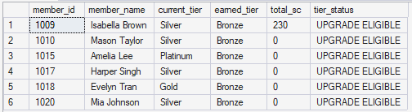
DQL: Calculate total SC per member, tier earned, mismatches and upgrade opportunities Part 2
-- Step 3: Use Step 2 to find mismatches
tier_mismatches AS (
SELECT
*,
CASE
WHEN current_tier <> earned_tier THEN 'UPGRADE ELIGIBLE'
WHEN current_tier = earned_tier THEN 'OK'
ELSE 'CHECK'
END AS tier_status
FROM tier_earned
-- ^^^^^^^^^^^ Using Step 2!
)
-- Final: Show only upgrade opportunities
SELECT
member_id,
member_name,
current_tier,
earned_tier,
total_sc,
tier_status
FROM tier_mismatches
WHERE tier_status = 'UPGRADE ELIGIBLE'
ORDER BY total_sc DESC;

Slide 18
DQL: Tier close Campaign Part 1
WITH-- Step 1: Total status credits
member_status_credits AS (
SELECT
member_id,
SUM(status_credits) AS total_sc
FROM flights
GROUP BY member_id
),-- Step 2: Eligible flight count
member_eligible_flights AS (
SELECT
member_id,
COUNT(*) AS eligible_flights
FROM flights
WHERE eligible_flight = 1
GROUP BY member_id
),-- Step 3: Most recent flight
member_last_flight AS (
SELECT
member_id,
MAX(flight_date) AS last_flight_date
FROM flights
GROUP BY member_id

Slide 19
DQL: Tier close Campaign Part 2
),-- Step 4: Combine all metrics
member_summary AS (
SELECT
m.member_id,
m.member_name,
m.email,
m.current_tier,
ISNULL(sc.total_sc, 0) AS total_sc,
ISNULL(ef.eligible_flights, 0) AS eligible_flights,
lf.last_flight_date,
CASE
WHEN lf.last_flight_date IS NOT NULL
THEN DATEDIFF(DAY, lf.last_flight_date, '2024-12-01')
ELSE NULL
END AS days_since_last
FROM members m
LEFT JOIN member_status_credits sc ON m.member_id = sc.member_id
LEFT JOIN member_eligible_flights ef ON m.member_id = ef.member_id
LEFT JOIN member_last_flight lf ON m.member_id = lf.member_id

Slide 20
DQL: Tier close Campaign Part 3
),-- Step 5: Identify tier-close customers
tier_close_customers AS (
SELECT
*,
CASE
WHEN total_sc BETWEEN 250 AND 299 THEN 'Close to Silver'
WHEN total_sc BETWEEN 650 AND 699 THEN 'Close to Gold'
WHEN total_sc BETWEEN 1350 AND 1399 THEN 'Close to Platinum'
ELSE NULL
END AS tier_opportunity,
CASE
WHEN total_sc BETWEEN 250 AND 299 THEN 300 - total_sc
WHEN total_sc BETWEEN 650 AND 699 THEN 700 - total_sc
WHEN total_sc BETWEEN 1350 AND 1399 THEN 1400 - total_sc
ELSE NULL
END AS sc_needed,
4 - eligible_flights AS flights_needed
FROM member_summary
WHERE (total_sc BETWEEN 250 AND 299
OR total_sc BETWEEN 650 AND 699
OR total_sc BETWEEN 1350 AND 1399)

Slide 21
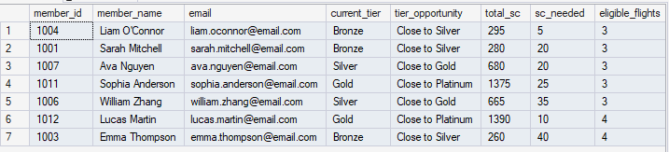
DQL: Tier close Campaign Part 4
)-- Final: Filtered, prioritised list
SELECT
member_id,
member_name,
email,
current_tier,
tier_opportunity,
total_sc,
sc_needed,
eligible_flights,
flights_needed,
days_since_last,
CASE
WHEN sc_needed <= 20 AND flights_needed = 1 THEN 'HIGH PRIORITY'
WHEN sc_needed <= 50 AND flights_needed = 1 THEN 'MEDIUM PRIORITY'
ELSE 'STANDARD'
END AS campaign_priority,
CONCAT('Offer ', sc_needed * 2, ' bonus points') AS offer
FROM tier_close_customers
WHERE eligible_flights >= 3
AND days_since_last IS NOT NULL
AND days_since_last <= 180
ORDER BY
CASE
WHEN sc_needed <= 20 AND flights_needed = 1 THEN 1
WHEN sc_needed <= 50 AND flights_needed = 1 THEN 2
ELSE 3
END,
sc_needed;

Slide 22
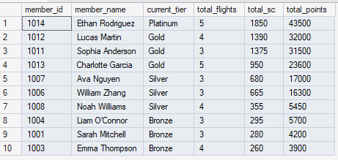
DQL: Member Flight Summary with 3+ flights
WITH member_flight_summary AS (
SELECT
m.member_id,
m.member_name,
m.current_tier,
COUNT(f.flight_id) AS total_flights,
ISNULL(SUM(f.status_credits), 0) AS total_sc,
ISNULL(SUM(f.points_earned), 0) AS total_points
FROM members m
LEFT JOIN flights f ON m.member_id = f.member_id
GROUP BY m.member_id, m.member_name, m.current_tier
)
SELECT
member_id,
member_name,
current_tier,
total_flights,
total_sc,
total_points
FROM member_flight_summary
WHERE total_flights >= 3
ORDER BY total_sc DESC;

Slide 23

DQL: Premium vs. Economy Part 1
WITH
-- CTE 1: Business/First class flights per member
premium_flights AS (
SELECT
member_id,
COUNT(*) AS premium_flight_count,
SUM(status_credits) AS premium_sc,
SUM(points_earned) AS premium_points
FROM flights
WHERE flight_class IN ('Business', 'First')
GROUP BY member_id
),
-- CTE 2: Economy flights per member
economy_flights AS (
SELECT
member_id,
COUNT(*) AS economy_flight_count,
SUM(status_credits) AS economy_sc,
SUM(points_earned) AS economy_points
FROM flights
WHERE flight_class = 'Economy'
GROUP BY member_id
)

Slide 24
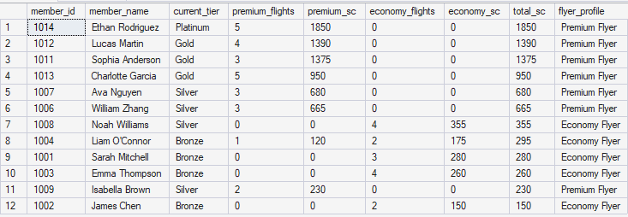
DQL: Premium vs. Economy Part 2
-- Join both CTEs to compare
SELECT
m.member_id,
m.member_name,
m.current_tier,
ISNULL(p.premium_flight_count, 0) AS premium_flights,
ISNULL(p.premium_sc, 0) AS premium_sc,
ISNULL(e.economy_flight_count, 0) AS economy_flights,
ISNULL(e.economy_sc, 0) AS economy_sc,
ISNULL(p.premium_sc, 0) + ISNULL(e.economy_sc, 0) AS total_sc,
CASE
WHEN ISNULL(p.premium_sc, 0) > ISNULL(e.economy_sc, 0) THEN 'Premium Flyer'
WHEN ISNULL(e.economy_sc, 0) > ISNULL(p.premium_sc, 0) THEN 'Economy Flyer'
ELSE 'Mixed'
END AS flyer_profile
FROM members m
LEFT JOIN premium_flights p ON m.member_id = p.member_id
LEFT JOIN economy_flights e ON m.member_id = e.member_id
WHERE ISNULL(p.premium_flight_count, 0) + ISNULL(e.economy_flight_count, 0) > 0
ORDER BY total_sc DESC;

Slide 25
DQL: CTE Chain – Route Popularity Part 1
-- SOLUTION:
WITH
-- Step 1: Count flights per route
route_flight_count AS (
SELECT
route,
COUNT(*) AS total_flights,
COUNT(DISTINCT member_id) AS unique_members
FROM flights
GROUP BY route
),
-- Step 2: Calculate average SC per route
route_avg_sc AS (
SELECT
route,
AVG(status_credits) AS avg_sc_per_flight,
SUM(status_credits) AS total_sc_on_route
FROM flights
GROUP BY route
),

Slide 26
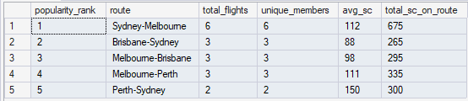
DQL: CTE Chain – Route Popularity Part 2
-- Step 3: Rank routes by total flights (using Step 1)
route_ranked AS (
SELECT
rfc.route,
rfc.total_flights,
rfc.unique_members,
rasc.avg_sc_per_flight,
rasc.total_sc_on_route,
ROW_NUMBER() OVER (ORDER BY rfc.total_flights DESC) AS popularity_rank
FROM route_flight_count rfc
JOIN route_avg_sc rasc ON rfc.route = rasc.route
)
-- Final: Show top 5 routes
SELECT TOP 5
popularity_rank,
route,
total_flights,
unique_members,
ROUND(avg_sc_per_flight, 0) AS avg_sc,
total_sc_on_route
FROM route_ranked
ORDER BY popularity_rank;

Slide 27
DQL: Tier Upgrade Candidates Part 1
WITH
-- Step 1: Calculate total Status Credits per member
member_sc AS (
SELECT
member_id,
SUM(status_credits) AS total_sc
FROM flights
GROUP BY member_id
),
-- Step 2: Count eligible flights per member
member_eligible AS (
SELECT
member_id,
COUNT(*) AS eligible_flights
FROM flights
WHERE eligible_flight = 1
GROUP BY member_id
),

Slide 28

DQL: Tier Upgrade Candidates Part 2
-- Step 3: Determine recency
member_recency AS (
SELECT
member_id,
MAX(flight_date) AS last_flight_date,
DATEDIFF(DAY, MAX(flight_date), GETDATE()) AS days_since_last
FROM flights
GROUP BY member_id
),
-- Step 4: Combine all members (NO FILTERING HERE)
upgrade_candidates AS (
SELECT
m.member_id,
m.member_name,
m.email,
m.current_tier,
ISNULL(sc.total_sc, 0) AS total_sc,
ISNULL(me.eligible_flights, 0) AS eligible_flights,
mr.last_flight_date,
ISNULL(mr.days_since_last, 9999) AS days_since_last,
700 - ISNULL(sc.total_sc, 0) AS sc_needed_for_gold
FROM members m
LEFT JOIN member_sc sc ON m.member_id = sc.member_id
LEFT JOIN member_eligible me ON m.member_id = me.member_id
LEFT JOIN member_recency mr ON m.member_id = mr.member_id
WHERE m.current_tier = 'Silver'
)

Slide 29
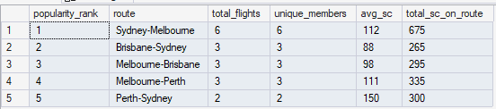
DQL: Tier Upgrade Candidates Part 3
-- Final Selection (controlled, visible filtering)
SELECT
member_id,
member_name,
email,
current_tier,
total_sc,
sc_needed_for_gold,
eligible_flights,
days_since_last,
CASE
WHEN total_sc BETWEEN 600 AND 699
AND eligible_flights >= 3
AND days_since_last <= 180
THEN 'CAMPAIGN ELIGIBLE'
WHEN total_sc < 600
THEN 'INSUFFICIENT STATUS CREDITS'
WHEN eligible_flights < 3
THEN 'NEEDS MORE FLIGHTS'
WHEN days_since_last > 180
THEN 'INACTIVE'
ELSE 'REVIEW'
END AS campaign_status
FROM upgrade_candidates
WHERE total_sc >= 500 -- soft guardrail (optional)
ORDER BY sc_needed_for_gold ASC;

Slide 30

DQL: Inactive High-Value Members Part 1
-- SOLUTION:
WITH
-- Step 1: Calculate lifetime SC per member
member_lifetime_sc AS (
SELECT
member_id,
SUM(status_credits) AS lifetime_sc,
SUM(points_earned) AS lifetime_points,
COUNT(*) AS total_flights
FROM flights
GROUP BY member_id
),
-- Step 2: Get last flight information
member_last_activity AS (
SELECT
member_id,
MAX(flight_date) AS last_flight_date,
DATEDIFF(MONTH, MAX(flight_date), GETDATE()) AS months_inactive,
DATEDIFF(DAY, MAX(flight_date), GETDATE()) AS days_inactive
FROM flights
GROUP BY member_id
),

Slide 31
DQL: Inactive High-Value Members Part 2
-- Step 3: Combine and identify inactive high-value members
inactive_high_value AS (
SELECT
m.member_id,
m.member_name,
m.email,
m.current_tier,
m.home_city,
ISNULL(lsc.lifetime_sc, 0) AS lifetime_sc,
ISNULL(lsc.lifetime_points, 0) AS lifetime_points,
ISNULL(lsc.total_flights, 0) AS total_flights,
la.last_flight_date,
la.months_inactive,
la.days_inactive
FROM members m
LEFT JOIN member_lifetime_sc lsc ON m.member_id = lsc.member_id
LEFT JOIN member_last_activity la ON m.member_id = la.member_id
WHERE m.current_tier IN ('Gold', 'Platinum')
AND la.months_inactive >= 12
)

Slide 32
DQL: Inactive High-Value Members Part 3
-- Final: Win-back campaign recommendations
SELECT
member_id,
member_name,
email,
current_tier,
home_city,
lifetime_sc,
lifetime_points,
total_flights,
last_flight_date,
months_inactive,
CASE
WHEN months_inactive >= 24 THEN 'CRITICAL - 2+ years inactive'
WHEN months_inactive >= 18 THEN 'HIGH RISK - 18+ months'
WHEN months_inactive >= 12 THEN 'AT RISK - 12+ months'
END AS risk_category,
CASE
WHEN current_tier = 'Platinum' THEN 'Offer 20,000 bonus points'
WHEN current_tier = 'Gold' THEN 'Offer 10,000 bonus points'
END AS win_back_offer
FROM inactive_high_value
ORDER BY
CASE
WHEN current_tier = 'Platinum' THEN 1
WHEN current_tier = 'Gold' THEN 2
END,
months_inactive DESC;

